Slide 1

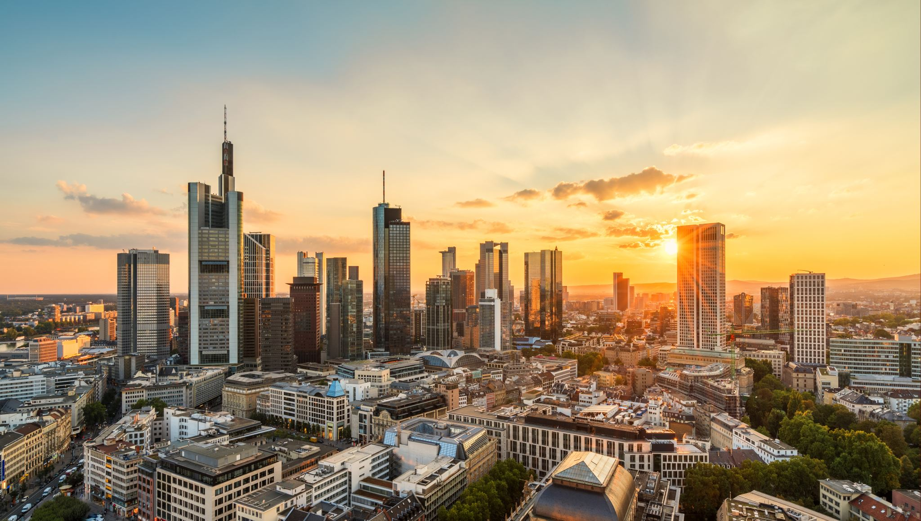
Coffee Supplier Target Locations
-Michael Henni

Slide 2
Problem At Hand
A new business owner is looking to generate sales and get his product in the hands of Coffee Shops.
The new business owner has limited resources so would like to focus sales efforts on locations in his hometown of Toronto, where Coffee Shops are common.

Slide 3
Data Acquisition
Toronto Postal Codes, Neighborhoods, and boroughs were gathered from https://en.wikipedia.org/wiki/List_of_postal_codes_of_Canada:_M.
Geospatial Data was provided by Coursera directly in an excel document.
Venue location was sourced from FourSquare

Slide 4
Methodology
I structured the data to see what regions of Toronto had Coffee Shops in the top five most common venue types.
This list is actionable, but to add better visualization I mapped the regions using Folium.

Slide 5
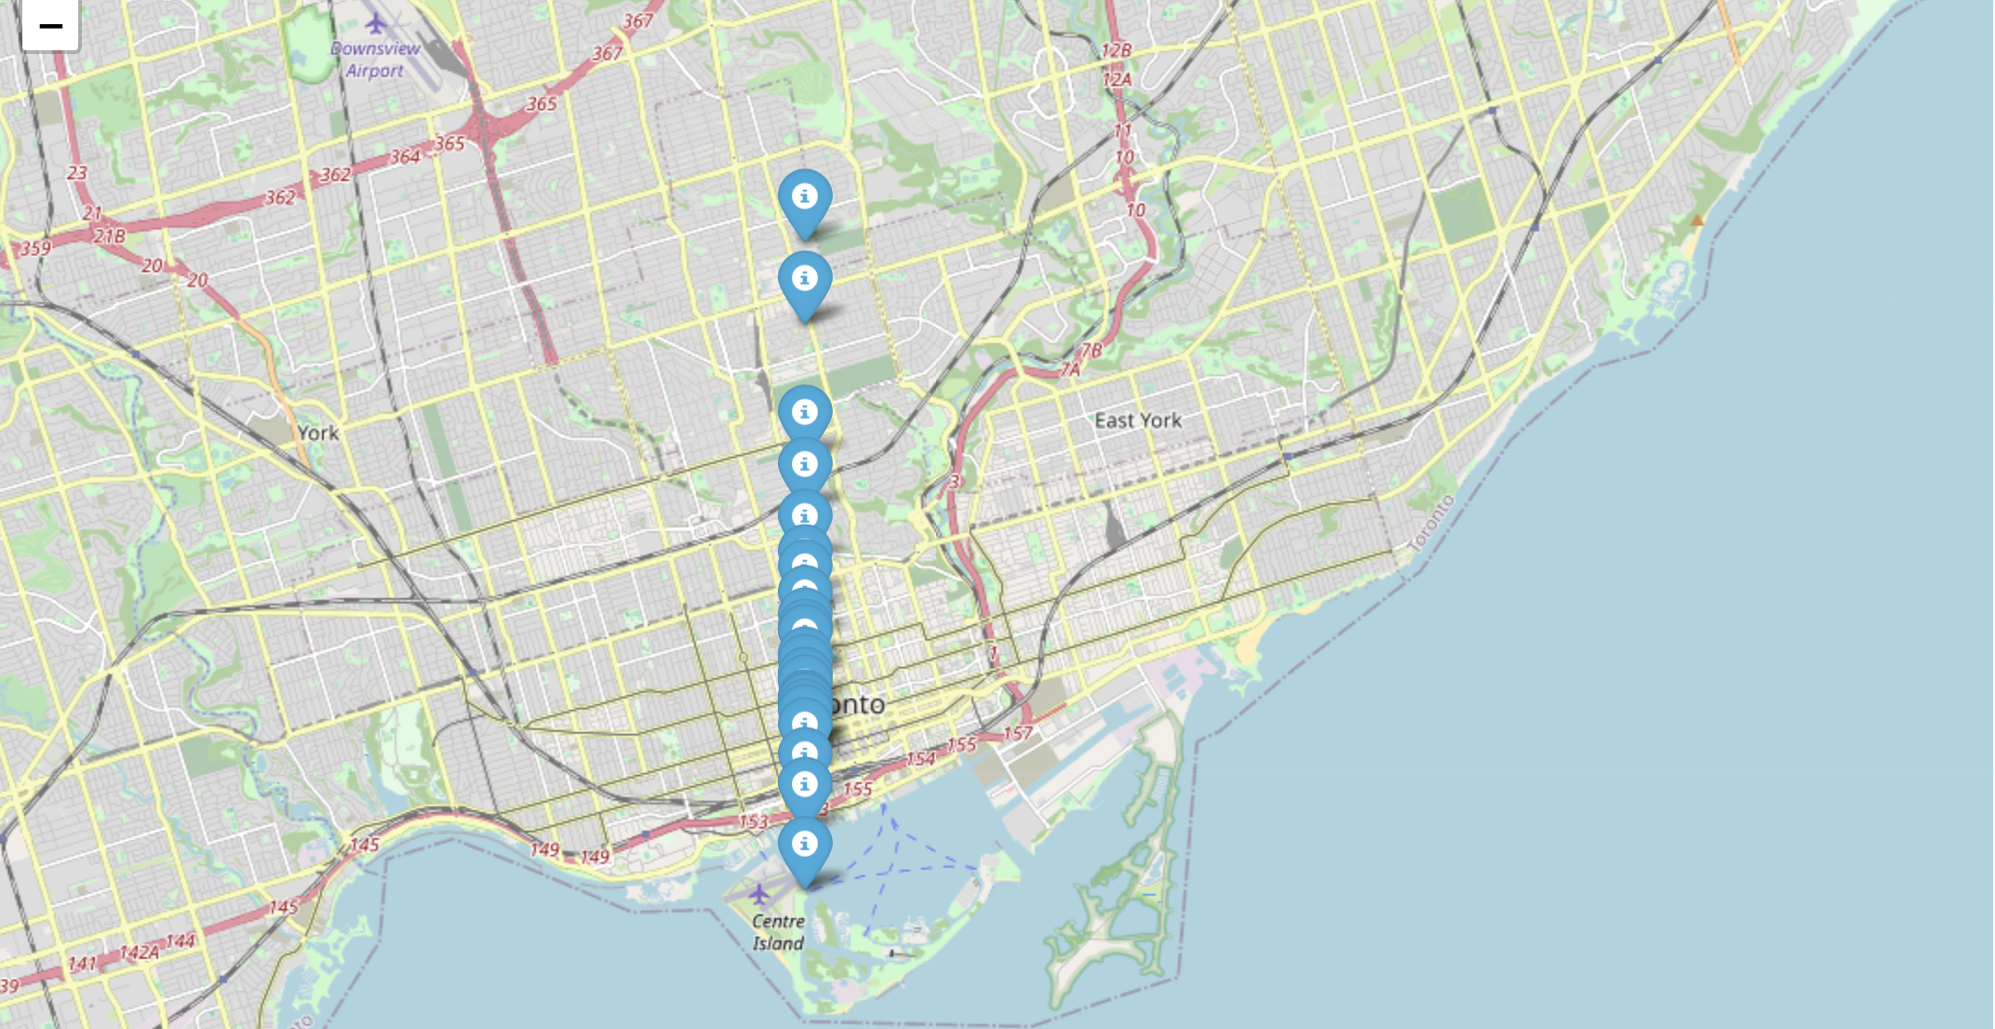
Coffee Supplier Target Areas

